Slide 1
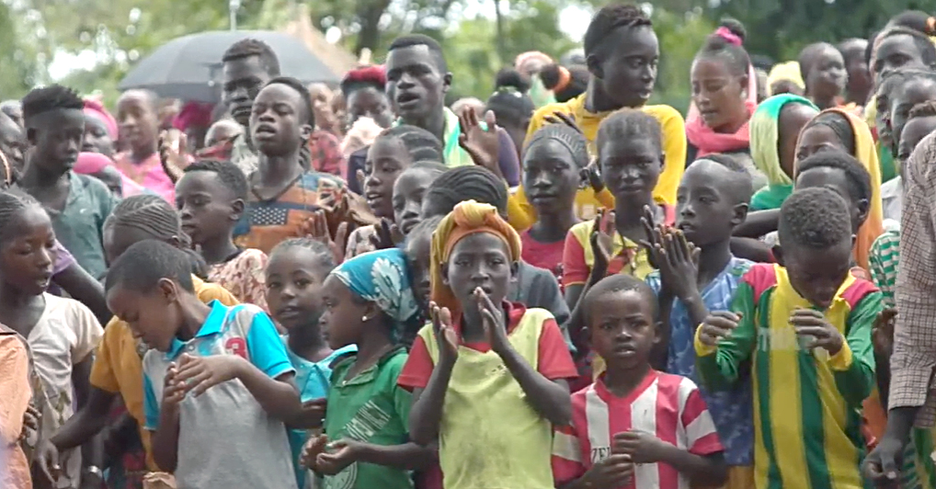
Sharing COBT with Others

Slide 2
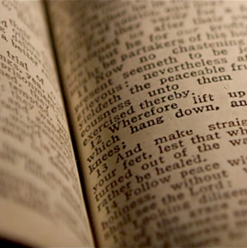
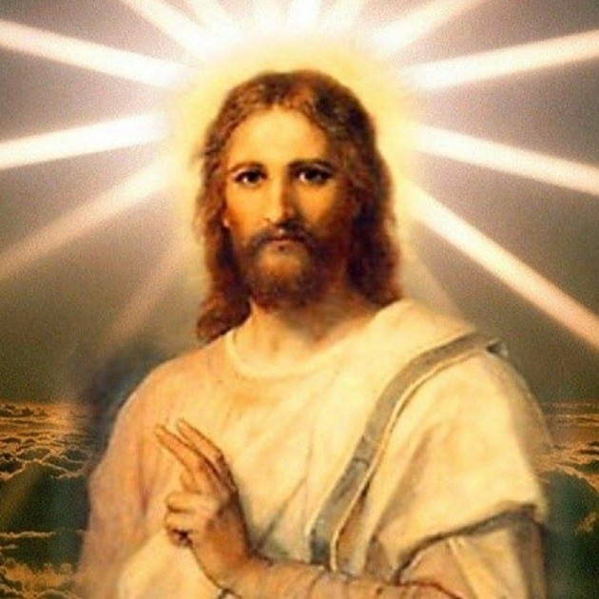
The Great Commission Includes Bible Translation
Romans 10:17
The Bible teaches:
The Gospel
The Commands of Jesus

Slide 3
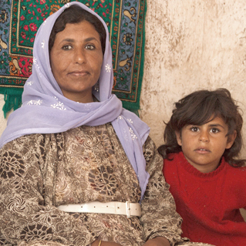
?
Who lives nearby?
Scripture needs
How to help
Other needs in the region / country

Slide 4
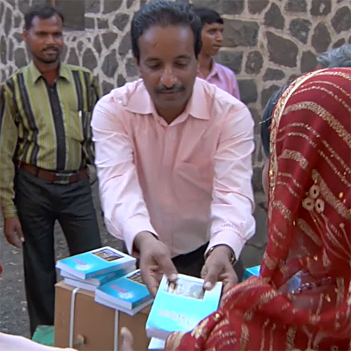
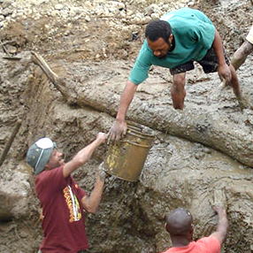
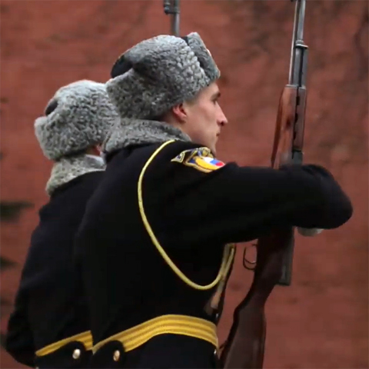
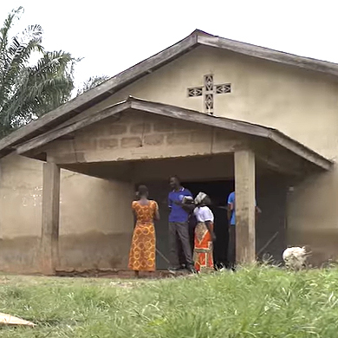
Scripture Changes the Community
Opposition becomes saved witnesses
Neighbors show love and support
Translators risk their lives
People are baptized and join the church

Slide 5


